Slide 1
One Codebase: Windows, Web, Mobile
Using .NET MAUI Blazor & Blazor

Slide 2

About Your Speaker
Mitch Sellers
Microsoft MVP, ASPInsider, etc
CEO @ IowaComputerGurus, Inc.
Contact Info
msellers@iowacomputergurus.com
@mitchelsellers
www.mitchelsellers.com

Slide 3

Agenda
The Development Scenario
System Requirements
Traditional .NET Mobile Options
What is MAUI Blazor
Minimum Versions
Store/Submission Considerations
Bringing in Web

Slide 4
System Requirements for Lab
Processor
Intel or AMD if you want to run the Emulator
Visual Studio 2022
Latest Version
MAUI Workload Installed
Android Emulator for Setup
Admin Rights

Slide 5

The Development Scenario
Mobile, Desktop, and Web are Desired
Creation of a Web interface that requires MINIMAL extra effort to manage/manipulate
Creation of an easy process to build/test/package the entire solution at once
Responsive Mobile does not provide enough options
API’s and backend logic are not included in today’s discussion

Slide 6

Traditional .NET Mobile
.NET MAUI
XAML Based
Windows, Mac, iOS, Android, Tizen
UNO Platform
C# XAML Based
Windows, Mac, iOS, Androiz, Tizen, WASM, and Linux

Slide 7
Introducing .NET MAUI Blazor
Think of it as a web app that runs on mobile
Fully supports multiple targets, including access to device specific hardware (camera, nfc, etc)
Apple
Android
Windows
Mac
Design/Develop/Build like it is web
Introduces some minimum versions that should be understood

Slide 8
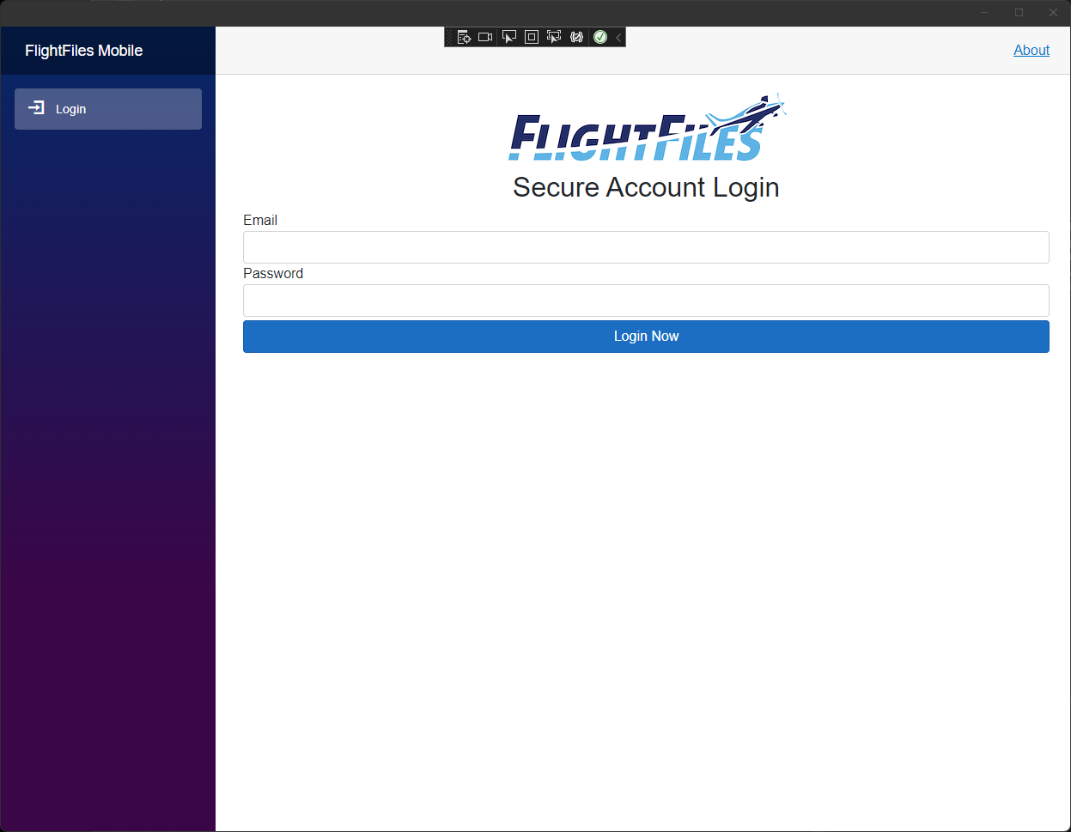
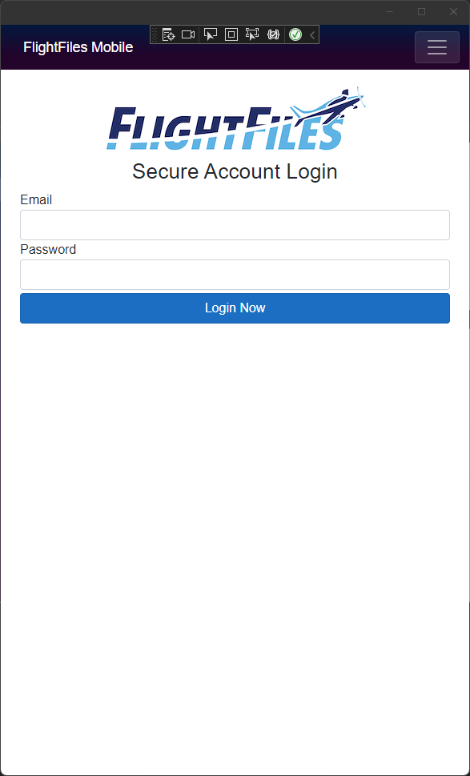
Example

Slide 9
.NET MAUI Blazor Minimum Target Versions
Requires Microsoft Edge WebView2
Minimums
Android 7.0 (API 24) – Given the support/rules with Android, no worries
iOS 14+ - For most, this isn’t a concern
macOS 11 or higher, using Mac Catalyst

Slide 10

Some Additional .NET MAUI Blazor Tips
No concern with publishing to the App Stores, but verbiage is key in submission.
On Windows you are running a web-app, this introduces a bit of a limitation with recent Windows 11 Releases
Developer Support/Advancement is Swift, Update regularly

Slide 11

How About Web?
Some individuals are looking for a truly “consistent” experience across all device types, this can be achieved with a slight re-architecture of the existing solution.
Business Use Cases
Ease of deployment, but multi-targeted
Flexibility, but singular training
Pitfalls from Production Usage
Platform Specific Changes are hard
Is it really the “Right” user experience

Slide 12
Making It Happen
.NET MAUI Blazor
ASP.NET Core Blazor
Razor Class Library

Slide 13
Where Code Lives
High-Level Components – Components Project
View Models
Views
Routing/Page setup – Individual UI Projects
Visual Studio has a project setup example, and a tutorial

Slide 14
Goals for Today
Understanding .NET MAUI Blazor Basics
Creating a new project, from scratch
Understanding Components, Composition, and Shared Assets
Interaction between MAUI -> JS and MAUI -> Device
Taking It Forward – Authentication

Slide 15

Let’s Get Started!

